Slide 1
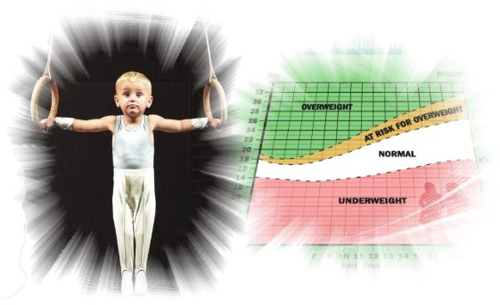
Assessment of the nutrition and physical development of pre-school and primary school children practising artistic gymnastics
VI-th Bulgarian Nutrition Conference 2013
Stefan Kolimechkov
Lubomir Petrov, PhD
A. Alexandrova, PhD
L. Andreeva, PhD
Prof. P. Atanasov, PhD
National Sports Academy ‘Vassil Levski’ - Sofia

Slide 2
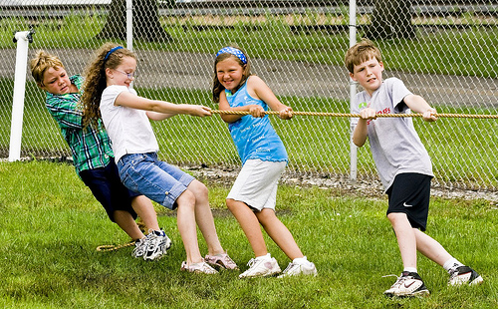
According to the National Centre of Public Health and Analysis (NCPHA) in Bulgaria, 200 000 children (or 20 % of the population) were overweight, of whom 65 000 were obese, in 2008.
It is recommended that youngsters spend at least one hour per day engaged in light to moderate physical activity, such as jogging, jumping, dancing and different kinds of sport (Booth et al., 2005).

Slide 3
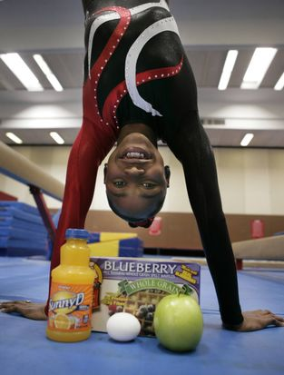
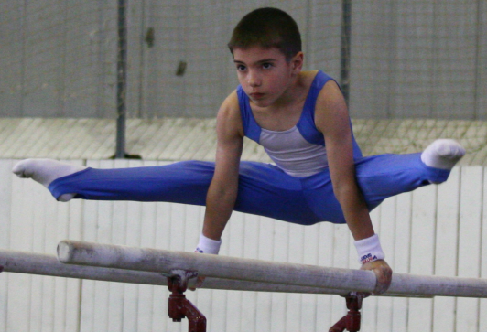
Artistic gymnastics is one of the few sports which children from pre-school and primary school can practise. It develops those main qualities which define physical fitness: strength, speed, endurance and flexibility.
The repeated physical activities require a proper nutritional regimen, providing the right amount of proteins, fats and carbohydrates, maintaining energy intake and optimal amounts of vitamins and minerals.

Slide 4
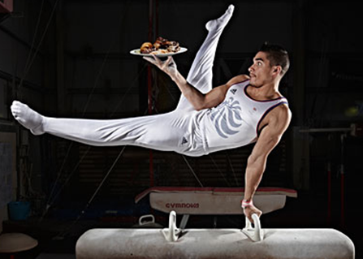
The recommended nutrient intake for children and adolescents who are engaged in extra physical activity is higher than that in ones who are not involved in sports. Child athletes need more protein than the recommended intake for those children who are not involved in physical activity.
Recommended additional intake of
carbohydrates (Nisevich, 2008) for light intensity training : 3-5 g/kg/24h; for moderate or heavy training: 5-8 g/kg/24h; for pre-event ‘loading’ (24-48 hours prior): 8-9 g/kg/24h; for post-event refueling (within 2-3 hours): 1.7 g/kg/24h.

Slide 5
Subject: The aim of this study was to assess, using accessible methods, the diet and the physical development of pre-school and young school children practising artistic gymnastics.
Methods
The study included 40 children (22 boys and 18 girls) between the ages of 4 and 12 years, attending gymnastics classes (3 to 5 times per week) at the ‘Sports Centre Levski’ in the capital of Bulgaria - Sofia. They were divided into two groups: pre-school (3-6 years of age) and primary school (7-11 years of age).

Slide 6
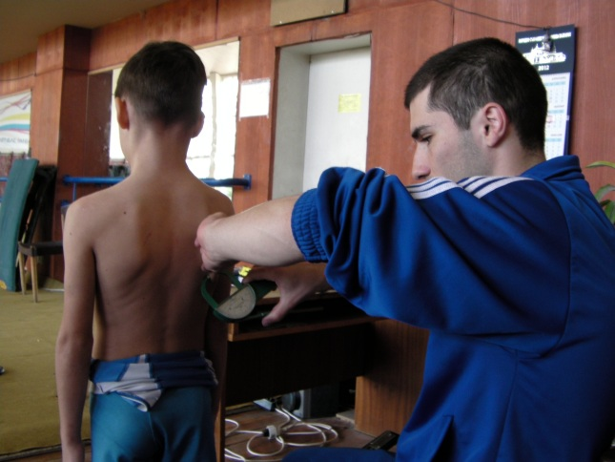
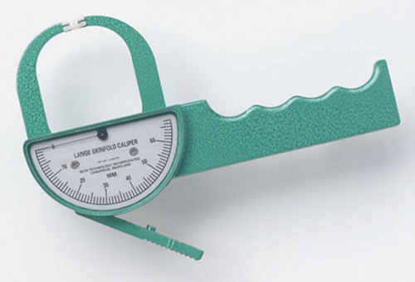
The standing height of the children was measured to the nearest 0.1 cm with a stadiometer, and their weight with an electronic scale to the nearest 50g. The body mass index (BMI) was also calculated, and in order to determine body composition and body fat percentage, we used the skinfold measurement test, which was carried out with a caliper (Lange Skinfold Caliper, Cambridge) to an accuracy of 1 mm.

Slide 7
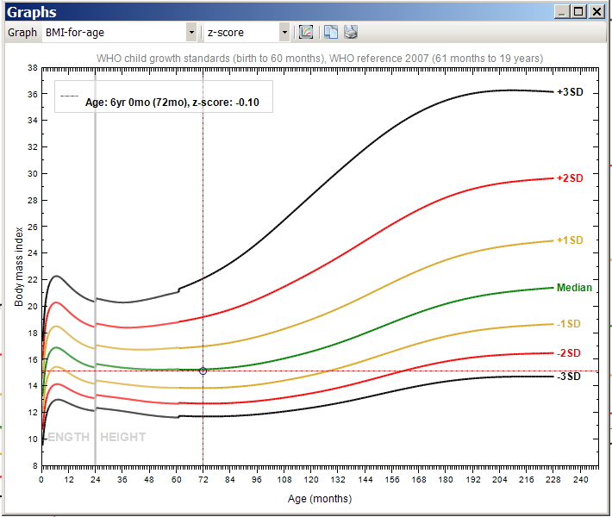
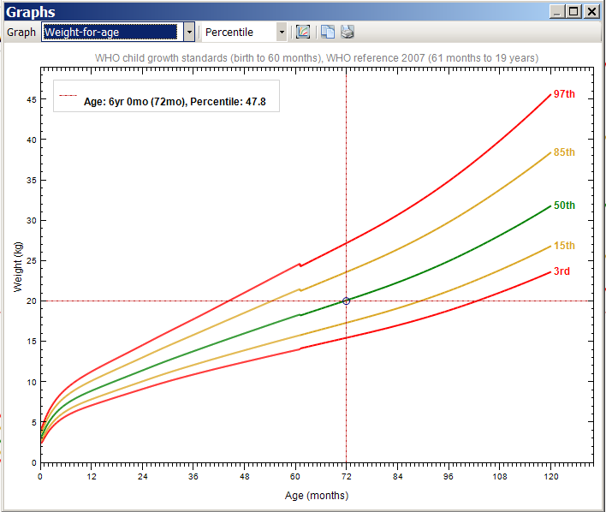
We used specialised software prepared by the World Health Organisation (WHO) – ‘WHO Anthro’ (for children under six years of age) and ‘WHO Anthro Plus’ (for children over 6 years of age), to assess height, weight and BMI in children. For each variable we calculated the Z-score and percentile score for the relevant age.
To distinguish the BMI scores, we used references provided by the WHO for children from 5 to 19 years of age.
overweight > +1 SD, obese > +2 SD, underweight < -2SD, mortality <-3SD
For percentile score :
85-95 percentile – overweight and >95 percentile – obese.

Slide 8
The upper arm muscle area – (UAMA) was calculated using the formulae: UAMA = [ (mid-) upper arm circumference - (π x triceps skin fold )]²/4π
Body fat percentage (% fat) was determined by the sum (Sum) of the two skin folds – triceps and scapula, using the equations of Slaughter:
Boys under 10 years of age: %Fat = 1.21 x Sum - 0.008 x Sum² - 1.7
Boys between age of 11-13: %Fat = 1.21 x Sum - 0.008 x Sum² – 3.4
Girls – all ages: %Fat = 1.33 x Sum - 0.013 x Sum² – 2.5
The basal metabolic rate (kcal/24h) was calculated using the formulae of Harris-Benedict. The estimated daily energy expended (kcal/24h) was derived by employing the basal metabolic rate (BMR) coefficient for physical activity, for which we adopted a figure of 1.4 for children practising 3 times per week, and 1.6 for children practising 6 times a week

Slide 9
The nutrition questionnaire which had been used for adult athletes (Zaikova 2010, 2011, 2012) was adapted for our purposes in order to assess the nutrient intake in children. The Food Frequency Questionnaire (FFQ) was completed by the children’s parents.
The test included 24 questions relating to the weekly consumption of basic foodstuffs.
Based on the results, the daily intake of proteins, carbohydrates and fats, protein/kg body weight, in addition to the total daily energy intake (kcal/24h) was calculated.

Slide 10
Results

Slide 11
Anthropometric data of the studied children (Average ± SD)
 | Males 3-6 years (n=7) | Females 3-6 years (n=5) | Males 7-11 years (n=11) | Females 7-11 years (n=10)
Age (y) | 5.00 ± 0.58 | 5.6 ± 0.89 | 7.55 ± 0.52 | 8.7 ± 2.11
Sports experience (months) | 7.43 ± 5.35 | 24.6 ± 12.28 | 26.82 ± 15.30 | 14.8 ± 13.97
Height (cm) | 112.17 ± 6.25 | 116.66 ± 5.91 | 126.27 ± 3.87 | 131.82 ± 12.09
Height Z-score | -0.28 ± 0.65 | 0.10 ± 0.87 | -0.28 ± 0.61 | -0.27 ± 1.12
Weight (kg) | 18.83 ± 2.83 | 21.6 ± 3.11 | 25.54 ± 2.79 | 30.87 ± 10.19
Weight Z-score | -0.39 ± 0.77 | 0.25 ± 0.66 | -0.10 ± 0.80 | -0.02 ± 1.09
BMI (kg/cm²) | 14.91 ± 1.30 | 15.79 ± 1.06 | 16.01 ± 1.59 | 17.30 ± 2.82
BMI Z-score | -0.37 ± 1.03 | 0.24 ± 0.67 | 0.04 ± 1.03 | 0.304 ± 0.86
Percentage body fat (%) | 12.07 ± 2.21 | 14.66 ± 2.74 | 12.53 ± 2.80 | 17.36 ± 5.64

Slide 12
Food intake data of the children from our study (aged 3-10 years) and children of the same age group from the Nutritional Survey of the population of Bulgaria – 1997
 | 3-6 years of age, urban population, Bulgaria 1997 | 3-6 years of age, children under study | 6-10 years of age, urban population, Bulgaria 1997 | 6-10 years of age, children under study
Expected energy expenditure (kcal/24 h) |  | 1423 ± 243 |  | 1558 ± 135.9
Energy intake (kcal/24 h) | 1740 ± 479 | 1503 ± 330 | 2069 ± 518 | 1831 ± 432.2
Protein (Е%) | 10.5 | 16.0 ± 1.7 | 10.7 | 16.1 ± 2.4
Fat (E%) | 37.3 | 33.3 ± 3.9 | 40.2 | 34.4 ± 4.5
Carbohydrates (E %) | 52.2 | 48.4 ± 4.7 | 49.1 | 47.3 ± 5.6
Protein / kg |  | 3.2 ± 0.9 |  | 2.9 ± 0.9
Protein (g/day) | 46.2 ± 12.3 | 60.4 ± 14.7 | 55.6 ± 14.7 | 73.9 ± 19.1
Fat (g) | 72.6 ± 21.6 | 55.6 ± 12.9 | 92.4 ± 29.5 | 70.0 ± 18.0
Carbohydrates (g) | 228 ± 70 | 182 ± 45.6 | 254 ± 72 | 217.1 ± 59.3
Baikova et al., Nutritional Survey of the population of Bulgaria, 1997

Slide 13
Overweight
BMI Z-scores for all children

Slide 14
Anthropometric data of the overweight children (BMI Z-score > 1)
№ | Age (years) | Sex | Sports experience (months) | Weight (kg) | BMI (kg/cm²) | BMI Z-score | Fat (%)
1 | 7 | M | 29 | 26.9 | 17.5 | 1.12 | 11.7
16 | 8 | M | 24 | 27.9 | 17.9 | 1.15 | 13.7
27 | 5 | M | 6 | 20.0 | 16.7 | 1.02 | 14.7
13 | 8 | M | 8 | 24.0 | 18.5 | 1.51 | 17.5
40 | 8 | F | 2 | 35.3 | 18.5 | 1.11 | 18.9
30 | 11 | F | 5 | 44.6 | 21.2 | 1.11 | 22.3
19 | 11 | F | 5 | 50.5 | 23.2 | 1.84 | 30.4

Slide 15
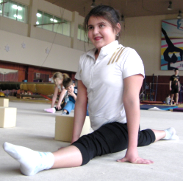
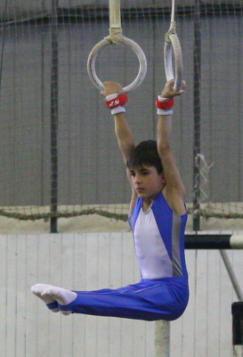
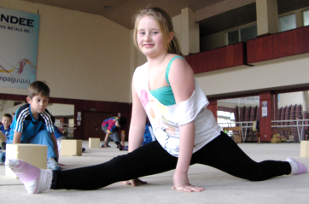

Slide 16
Average age, sports experience (months), calculated energy expenditure, energy intake and energy proportion of the essential nutrients in overweight children (n=5) and young athletes (n=12)

Slide 17
Energy expenditure and energy intake; protein, fat and carbohydrate / kg body weight (Average ± SE) in the overweight children (n=5) and children who were competitors (n=12).
Group | Competitors | Overweight | t-test
 | Average ± SD | Average ± SD
Energy expenditure (kcal/kg/24h) | 70.16 ± 8.82 | 48.73 ± 8.98 | p<0.001
Energy intake (kcal/kg/24h) | 72.32 ± 21.19 | 63.65 ± 15.28 | p>0.05
Protein (g/kg) | 2.87 ± 0.86 | 2.57 ± 0.80 | p>0.05
Fat (g/kg) | 2.65 ± 0.88 | 2.30 ± 0.50 | p>0.05
Carbohydrates (g/kg) | 8.86 ± 2.62 | 7.86 ± 2.02 | p>0.05

Slide 18
BMI Z-score and ratio (energy intake)/(energy expenditure) in the overweight children (n=5) and the children who were competitors (n=12)
* - p < 0.05; *** p < 0.001

Slide 19
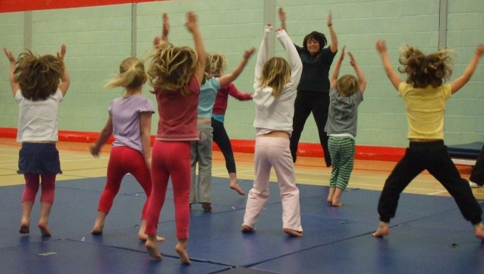
Conclusions and recommendations:
The volume of aerobic exercise in the preparatory part of the gymnastics session should be increased, in addition to various games and different athletic exercises which might be included.

Slide 20
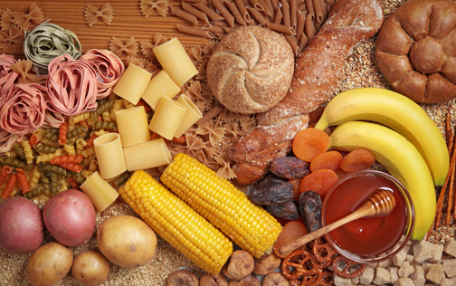
Foods with high energy content (bakery products, chocolate, candy, etc.) should be minimized, and those of fruits and vegetables maximized.
Children should be stimulated to eat more healthily.

Slide 21
BMI is not an adequate indicator for child athletes with greater muscle mass. In these cases, more anthropometric data (% fat, skin folds) should be taken, as well as strength indicators (data for muscle hypertrophy and dynamometers).
The nutrition questionnaire which was used gives a good indication of the average intake of the main food groups, nutrients and energy. This conclusion is confirmed by the close accordance between the data obtained in our study and that from others which have been conducted.
Information about extra physical activities, which is not part of the PE lessons or sports training, should be collected in order to assess correctly the energy expenditure in child athletes
The amount of aerobic exercise in training sessions should be increased for overweight children, and a healthy way of eating should be promoted for them and their parents.

Slide 22
The End
Thank You

